Slide 1
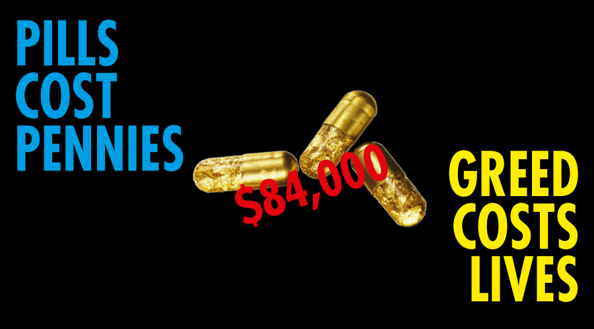
Access to medicines in Europe
Médecins du monde – Doctors of the World International Network
François Berdougo – Harm Reduction Working Group
Notes:
Good afternoon everybody,
This is a pleasure to be here with you today to express our deep concerns about the impact of drugs high prices on universal access to care and to share our thoughts to solve this problematic situation we have to deal with.

Slide 2
→ an independent international movement working across the world (78 countries), both at home (169 programmes) and abroad (147 programmes) → in Europe: asylum seekers, undocumented migrants, homeless people, Roma communities, elderly, destitute EU citizens or nationals, people who use drugs, sex workers → medical & social service delivery – data collection on persons not described in official statistics – social change through empowerment & advocacy
Doctors of the World – who we are & what we do
Notes:
Médecins du Monde / Doctors of the World is an international network acting as a medical NGO, which is both a care provider and an advocate.
Everywhere, and notably in Europe, we provide health services to some of the most vulnerable and hard-to-reach groups of population.
We aim to:
Deliver medical and social services;
Collect and analyze data from the field;
Promote social change.

Slide 3
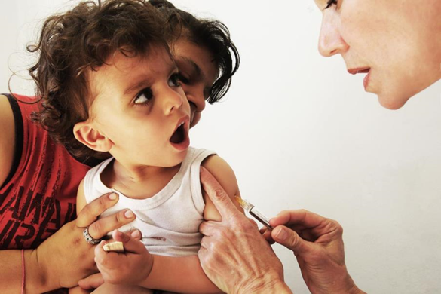
Access to healthcare for the most vulnerable in a Europe in social crisis. (May 2013) → 29,400 consultations across 25 cities in eight European countries → Among the children seen, on average only 50% had been vaccinated against tetanus. → On average, 70% had not been vaccinated, or did not know whether they had been vaccinated, against hep B, measles and pertussis (wooping cough).
Impact of the crisis on access to medicines
© Giorgos Moutafis
Notes:
Photo: Dr Liana MAILLI vaccinates a child at the clinic in Perama, MdM Greece, 2013.
Based on our experience through 8 European countries, we can document access to healthcare for the most vulnerable people, in the time of a deep financial and social crisis.
For example, our activity allows us to say that vaccine coverage can be low among some groups of population, as we see everyday within our programs.

Slide 4
No access to basic vaccines (tetanus, HBV, MMR, pertussis) MdM vaccinated 9,000 children in 2013 → Massive decreases in public health expenditure → Understaffing in healthcare facilities, in peripheral regions but also in Athens → Regular stock-outs → Increase in user charges for medication, including for diabetes, coronary heart disease, cancer… → Still close to 3 million people who lost their healthcare coverage → Health voucher system not yet effective → 1,200€ to fully vaccinate a child when uninsured…
Impact of the ‘crisis’ – The example of Greece
Notes:
Lacking access to vaccines also applies to medicines, e.g. data show frequent breaks in continuity of care.
More specifically, we contribute to show the negative consequences / outcomes of austerity measures / budget cuts that have been done in Greece on healthcare system and universal access to care.
This includes notably:
Increasing in user charges;
The lost of healthcare coverage for approximately 3 millions people…

Slide 5
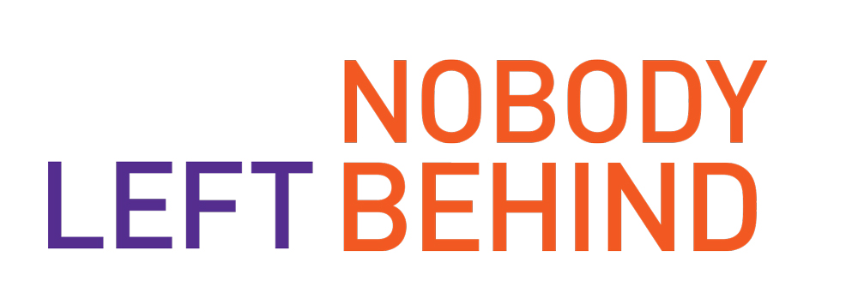
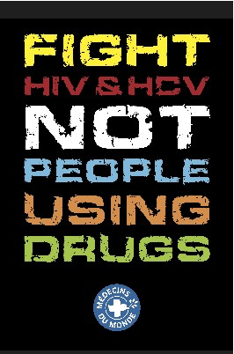
→ People who use drugs – and specifically who inject drugs – bear by far the heaviest burden of Hepatitis C (HCV); → 90% of new infections result from lack of access to sterile injecting equipment → 67% of the estimated 16 million people who inject drugs globally have been infected by HCV → MdM estimates that around 2 million people who inject drugs globally need treatment immediately → In high-income countries, the annual HCV treatment uptake of people who inject drugs remains very low, at around 1 or 2 %.
Notes:
Worldwide, Médecins du Monde promotes harm reduction policies and programs, especially for and with Injecting Drug Users (IDUs), who bear the heaviest burden of HCV but have very low access to life-saving drugs.
We defend the right of IDUs to access harm reduction services and treatment for HCV, and we make the demonstration of this policy feasibility through programs that are disseminated in Western or Oriental Europe, Central Asia, Middle-East and Africa.
Even in High Income Countries, access to HCV treatment for IDUs remains very low, around 1 or 2 %.

Slide 6
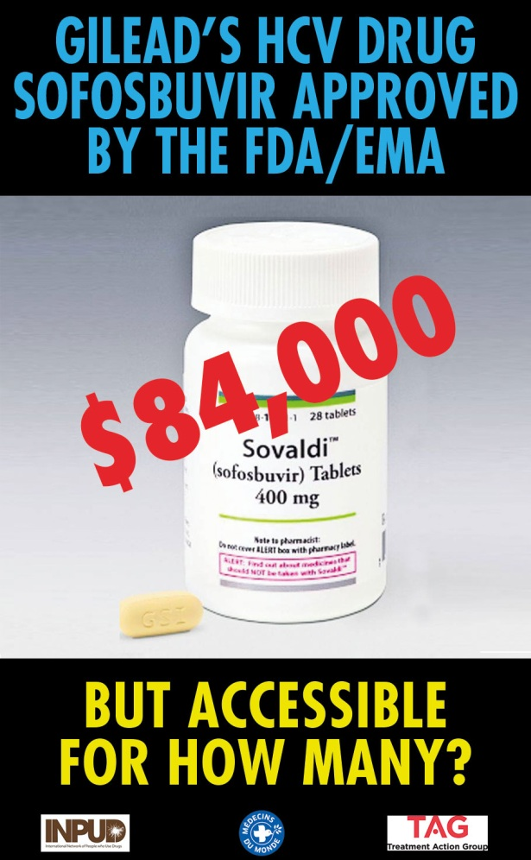
→ In high-income countries, only 1 to 2% of PWID access HCV treatment, because of stigma, criminalization, but also because of exorbitant treatment prices, especially for new Direct-Acting Antiviral Agents (DAA) Sofosbuvir (by Gilead) US: 84,000$ for a 12-week treatment FR: 56,000€ for a12-week treatment Up to €100,000 in combination with an other DAA → Prices remain unrealistically high both in LMICs AND in HICs This price has led to treatment rationing and exclusion of key populations in many places.
Prices of HCV treatment are exorbitant
Notes:
To achieve universal access to HCV treatment, we need affordable drugs, even in High Income Countries.
Prices that have been accepted in some countries, like the US, or that are considered within current negotiations in others, like France, are unbearable for many healthcare systems, especially in a period of general budget cuts which includes social services.
This level of price already have consequences on access to this drug. In France, we receive testimonies from healthcare providers and patients about the direct link between this high price and treatment rationing.

Slide 7
Notes:
In order to realize how this kind of price is out of healthcare system capacity, let me show you this figure. It compares the budget which would be needed to ensure access to sofosbuvir to every people living with chronic HCV, if the price remained 56 000 euros, with the annual budget of all the Parisian hospitas for 2014…
This price compromises universal access to HCV treatment, even in a country like France.

Slide 8
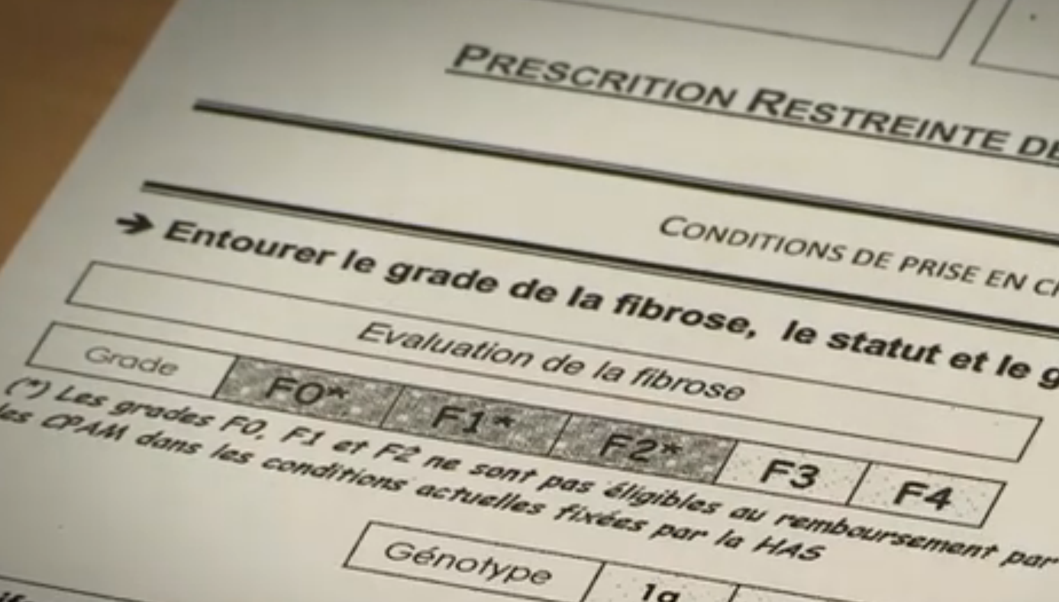
Example: treatment rationing in France
In Spring 2014, experts have recommended prioritizing treatment ≥ F2 and PWUD regardless their fibrosis stages
But a few months later, the public health authority – la Haute Autorité de Santé (HAS) – changed these recommendations and endorsed prioritization of people ≥ F3 with no mention of key populations
Notes:
In France for instance, the recommendations of the High Authority for Health didn’t follow the experts recommendations which were to treat with DAAs people with a fibrosis stage from F2 and above plus treating people who use drugs regardless their fibrosis stage
This restriction is clearly link to the impossible financial burden the french state has to face
We made a calculation, treating people with a fibrosis stage starting at F2, which is the treatment indication for peginterferon and ribavirine, with a sofosbuvir-based regimen would cost more than the entire 2014 budget for the Paris public hospital system—just for sofosbuvir. 7 billion of euros
You can see clearly on this prescription sheet, the grey part on F2 to F0

Slide 9
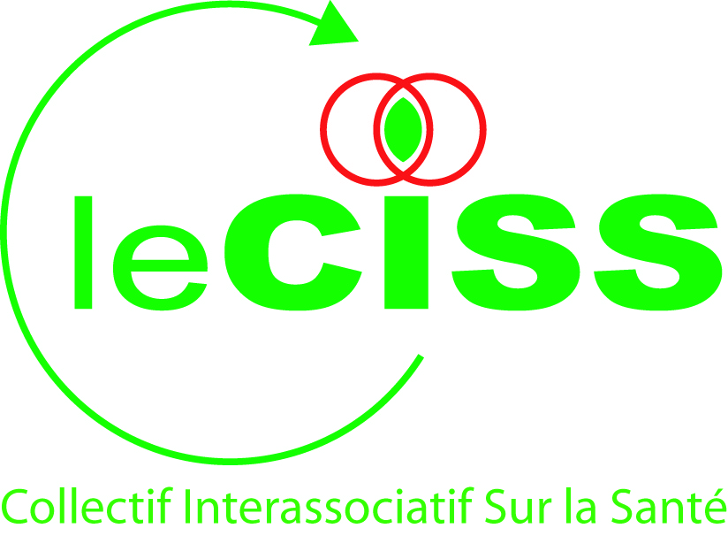
→ A wide coalition: patients (HCV, HIV and other diseases) and healthcare user organisations, medical NGOs → Allies: healthcare professionals, economists, university and researchers → Communication and mobilization: risk of rationing, transparency, compulsory licence → Lobby : hearing by the Pricing commission (CEPS, 1st hearing ever), meetings with MoH → Public events (Le Havre, MoH) → Today, public debate includes pricing criteria, new models for pharmaceutical development or pharmaceutical research financing
What did we do in France?

Slide 10
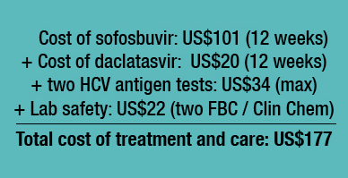
Because no tiered pricing and voluntary licensing pharma’s strategy will allow universal access; → Lessons learned from HIV: use of Trade-Related Aspects of Intellectual Property Rights (TRIPS) flexibilities to avoid rationing and exclusion of key populations → compulsory licences : (e.g. MdM advocacy towards French government) → patent opposition (e.g. India) and promotion of generic competition – only real novelties should be rewarded with a patent!
To overcome these barriers: promote generic competition
Hill, A, et al. Minimum target prices for production of treatment and associated diagnostics for hepatitis C in developing countries . International AIDS Conference; 2014 July 20–25; Melbourne, Australia.
Where there is competition from generics, prices can be driven down dramatically
Notes:
Particularly these two flexibilities worked to increase treatment access and should work for HCV treatment.
And for Sofosbuvir, which should be the back bone of most of the HCV treatments
In 2007, Brazil issued a compulsory license for efavirenz, and the five-year savings were more than USD103 million
In France, The government and Gilead are still under price negotiations
Sofosbuvir, despite its real therapeutic value for people with HCV, does not represent a “novelty” as defined by national patent laws in some countries,
Exemple In Egypt, the patent hasn’t been granted for lack of novelty
Opposition to Gilead’s patent on tenofovir > In September 2009, the Indian Patent Office (IPO) permanently revoked Gilead’s patent for TDF.
If SOF can be opposed for lack of novelty, it shows even more why voluntary licensing would not be a proper way forward (Gilead would receive royalties on a drug that can be opposed and a drug that does not deserve new exclusive rights)

Slide 11
Courtesy Pauline Londeix (ITPC-MENA)

Slide 12
→ Keep pressure on the institutions and other stakeholders → Maintain the public opinion’s interest → Prepare the Public Health Law to come in 2015 → Advocate towards the government and MPs → Promote new tools at European level
Next steps

Slide 13
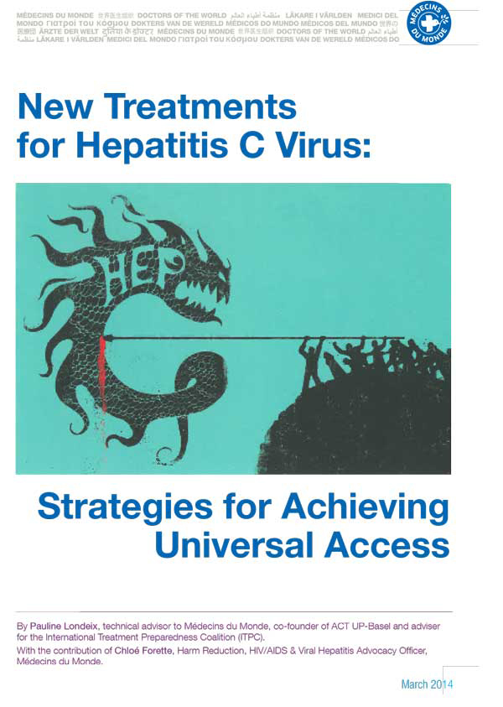
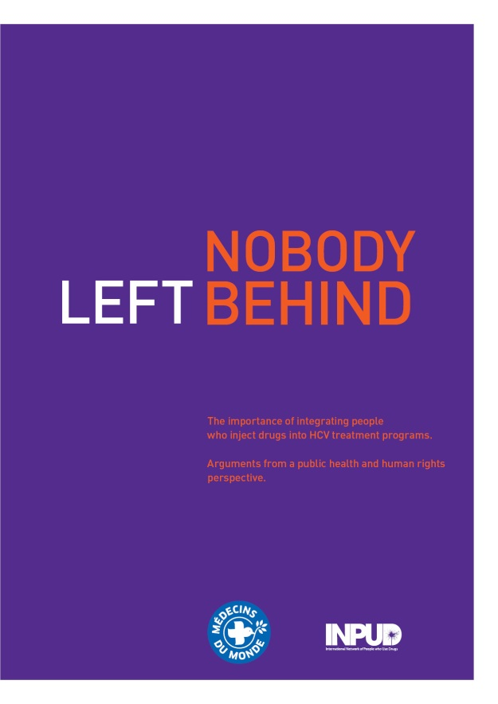
Thank you!
Francois.Berdougo@medecinsdumonde.net
Frank.Vanbiervliet@medecinsdumonde.net
Acknowledgment: Chloé Forette, Frank Vanbiervliet

